Slide 1
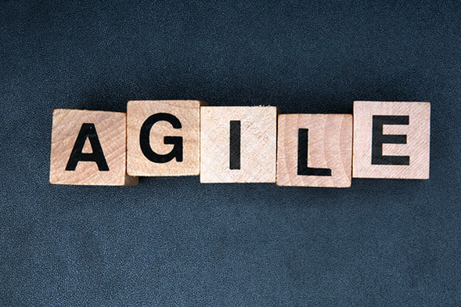
The Building Blocks of Agile Sophie Wong & Elizabeth McManus
Notes:
Lizz will give intro

Slide 2
What is Agile?
The Agile Manifesto was written in February of 2001, at a summit of 17 independent-minded practitioners of several programming methodologies. They developed the four main values for Agile
Individuals and interactions over processes and tools
Working software over comprehensive documentation
Customer collaboration over contract negotiation
Responding to change over following a plan
Some Known Agile Methodologies
Scrum – Goal is to delivery fully functional product after each and every iteration, which provides the highest business value
Lean – focused on delivery the “right” requirements to the business based on impact to business
Extreme Programming - focuses on communication, simplicity, feedback, and courage
Feature Driven Development – focus is collecting and creating a domain model which flushes out the requirements built in small iterations
Notes:
Sophie
Agile is NOT a methodology but a MINDSET.

Slide 3
Key Principles
From Scrum Inc.
Notes:
Lizz

Slide 4
What is Scrum?
Scrum is a lightweight agile project management framework
Scrum is named after Scrum in rugby, which is a way to restart the game after an accidental infringement
Notes:
Sophie

Slide 5
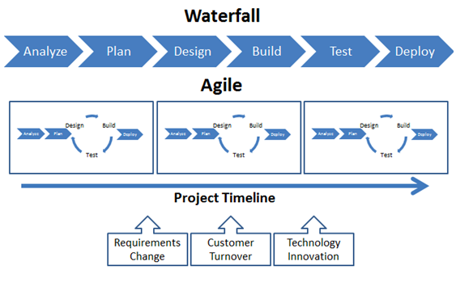
Waterfall vs. Agile
Notes:
Sophie

Slide 6
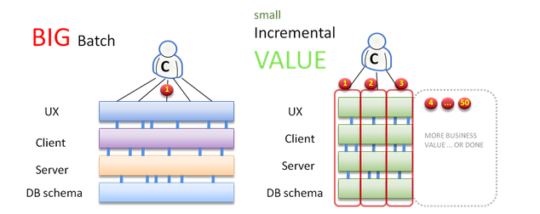
For Example…
Notes:
Lizz – use sitemap/navigation example
(yes it is ok to begin development in the beginning)

Slide 7
Why Scrum?
Builds team relationship, trust, and synergy
Constant user feedback & prioritization
Delivering most value in a timely basis
Empowering leadership style, self organizing teams
Only-needed documentation
Only-needed upfront planning
Delivers early partial working solutions with maximum business value
Promotes adaptive planning & flexible response to change
Short time-boxed iterations
Respond to change in environment - the world is changing!
Notes:
Lizz

Slide 8
Scrum Roles
Product Owner:
Responsible for representing the customer/user of the product the team is building.
Define & Prioritize the features of the product backlog
Decide on release date and content
Responsible for understanding the value of the product to the customer and being able to provide details for the stories (requirements)
Prepares stories for upcoming iterations.
Responsible for prioritizing product development features in each sprint and over course of entire project.
Scrum Master:
Manages the Scrum process, making the process work for the team.
Responsible for helping the team improve velocity. Watch for warning signs (too many starts, lack of transparencies/communications, etc)
Facilitates the scrum meetings
Focuses team on the highest priority work
Removes roadblocks, obstacles & shields team from interference and impediments
Team:
All team members are general team members and Cross functional – including testing
Self organizing, has autonomy regarding how to achieve its commitments
Notes:
Sophie

Slide 9
Notes:
Sophie
3 teams: scrum master, product owner, team
5 meeting: sprint planning, daily stand up, backlog refinement, sprint retrospective, sprint demo/review
Daily Stand-up (aka Daily Scrum) – 10 min where each team member talks about what they did yesterday and will do today, and if they have any blockers
Sprint Planning – team commits to a certain amount of work at the beginning of the sprint and plans how to deliver it
Sprint Review - at the end of the sprint, the team demoes their progress to the stakeholders
Sprint Retrospective - following the demo, the team discusses between themselves how to improve things next sprint

Slide 10
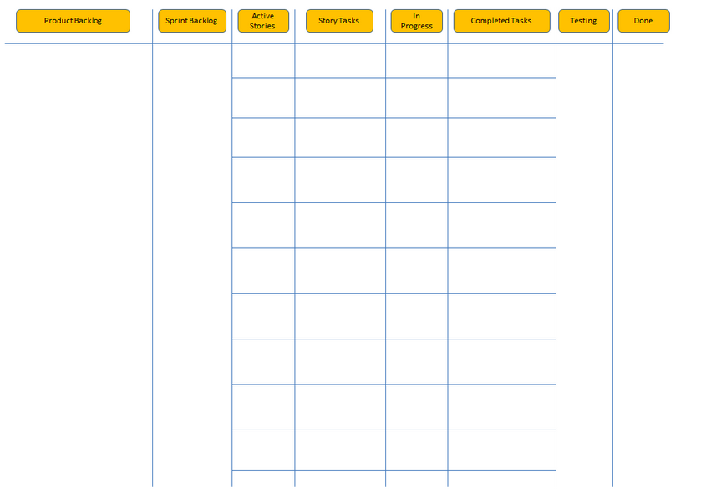
Scrum Board
Notes:
Lizz
One of three artifacts

Slide 11
Scrum Board
The Product Backlog consists of work to be done ordered by business value
Notes:
Lizz

Slide 12
Scrum Board
The sprint backlog is a list of tasks identified by the Scrum team to be completed during the Scrum sprint.
Notes:
Lizz

Slide 13
Scrum Board
Agile user stories are simple, clear, brief descriptions of functionality told from the perspective of a user. User stories in a Scrum or agile development project are written to describe the functionality a user or customer wants.
Notes:
Lizz

Slide 14
Scrum Board
Work in progress
Notes:
Lizz

Slide 15
Scrum Board
Any guesses?
Notes:
Lizz

Slide 16
Agile Challenges
Poor user stories, no clear definition of READY
Taking too much into a sprint and failing to deliver working software
Daily meeting not replanting and removing impediments
Not fixing bugs found inside a sprint, particular integration bugs
Working on too many stories at once inside the sprint
Failure to have a plan for interruptions or emergencies
No clear definition of DONE
Not executing improvements identified in the retrospective
Overburdening team
Ignoring impediments
List From Scrum Inc.

Slide 17
Glossary Game
How many Agile terms can you think of that begin with one of the following letters?
A
P
S
T
D
Notes:
Lizz

Slide 18
Agile Training Opportunities
Future of IT @ MIT
http://it.mit.edu/progress/training
Notes:
sophie

