Slide 1
Unified Communications (Collaboration Platforms)
June 2015
John Vosburg
Manager IS&T Collaboration Platforms

Slide 2
What is Unified Communications?
Unified communications (UC) is the integration of real-time communication services. UC is not a single product, but a set of products that provides a consistent user-experience across multiple devices and media-types.
Notes:
Voip trunks
IP Telephony
UC

Slide 3
UC Architecture
Internet
PSTN
5ESS
Expressway
Acme Packet
ISDN Phones
Analog Phones
External Connectivity
Unity
Provisioning
nameConnector
ENUM
DHCP
Support Services
UCCX
Services
WebEx
Sylantro
CUCM
OpenSER
User Services
Polycom Phones
Analog Adapters
Voice / Video
Personal SIP
Experimental
Notes:
Session Boarder Controllers
E.164 Carriers
Applications
Peer to Peer Connections
Polycom Phone Proxy
Expressway / Collab Edge
Internet @mit.edu
Cisco & Jabber Proxy

Slide 4
UC Projects
Analog
XMPP
Softphone
Video / WebEx
Voicemail
Phone
Call Center
Pilots

Slide 5
Analog
Currently with Lucent 5ESS
New Cisco VG350 analog gateways
2,600 of 5,000 lines have been migrated
Analog Choices
Critical service – VG350
Non-critical services – ATA

Slide 6
XMPP Platform
Currently OpenFire
New Cisco Unified Presence (CUP)
@mit.edu client support
Clients: Adium, Pidgin, iMessage, and Jabber
Persistent Chat Rooms
Federation with sub-domains and other domains
API for application integration

Slide 7
XMPP with Softphone
Jabber
Platform support
Windows
OS X
iOS
Limited Android support
Requires moving your phone number to the new Cisco platform

Slide 8
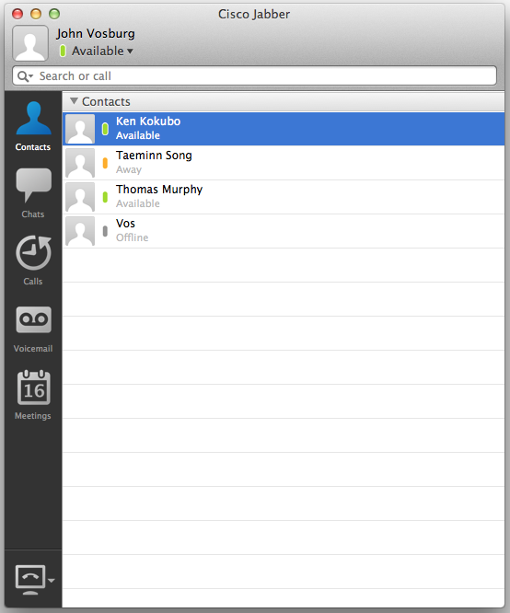
Jabber Desktop
Directory
IM / Presence
Video
Visual Voicemail
WebEx
Softphone / CTI
URI dialing
Notes:
XMPP based
V

Slide 9
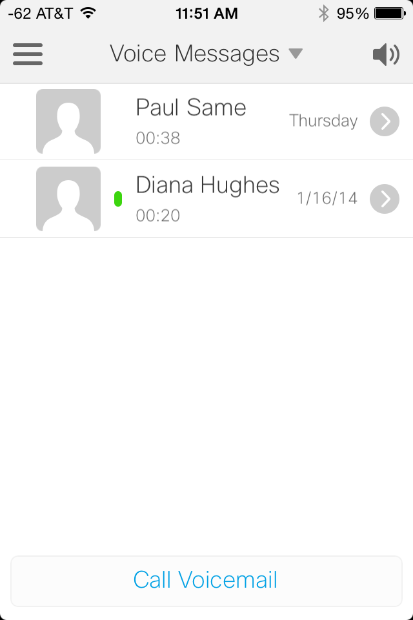
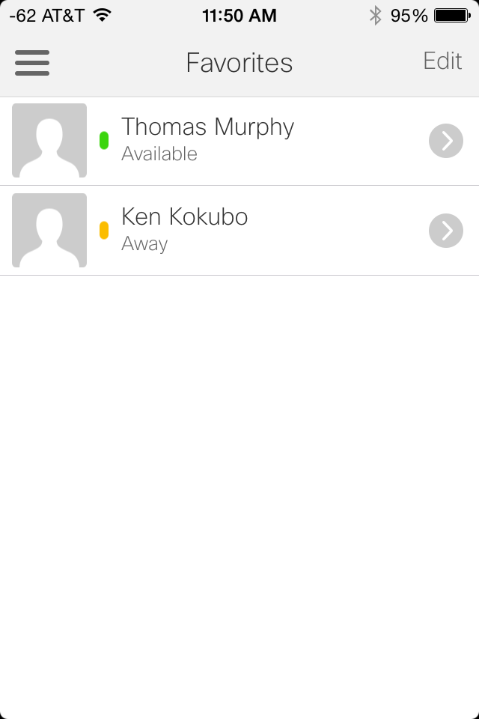
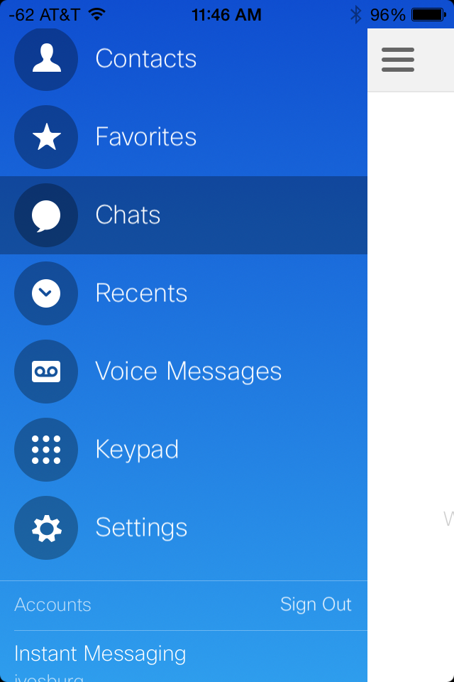
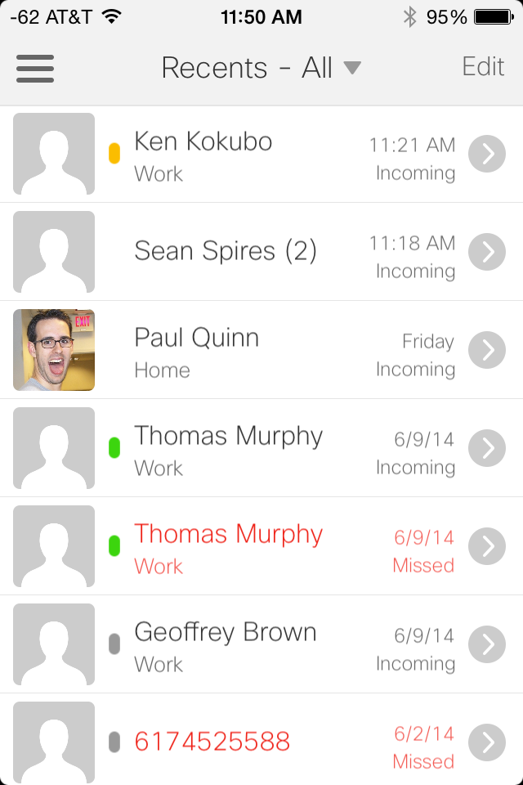
Jabber iOS
Directory
IM / Presence
Video
Visual Voicemail
URI dialing
External access

Slide 10
Voice & Video Services
Communications Manager voice/video PBX
Unified dialing
5-digit (45588)
10-digit (6173245588)
URI (jvosburg@mit.edu)
Shared line between all your devices
New user portal
Notes:
Merging of 2 dial plans: E.164 and SIP URI
Authentication
Tie into personal contacts
Phone bluetooth
Mobility of calls from desk to mobile
Secure internal and external registration

Slide 11
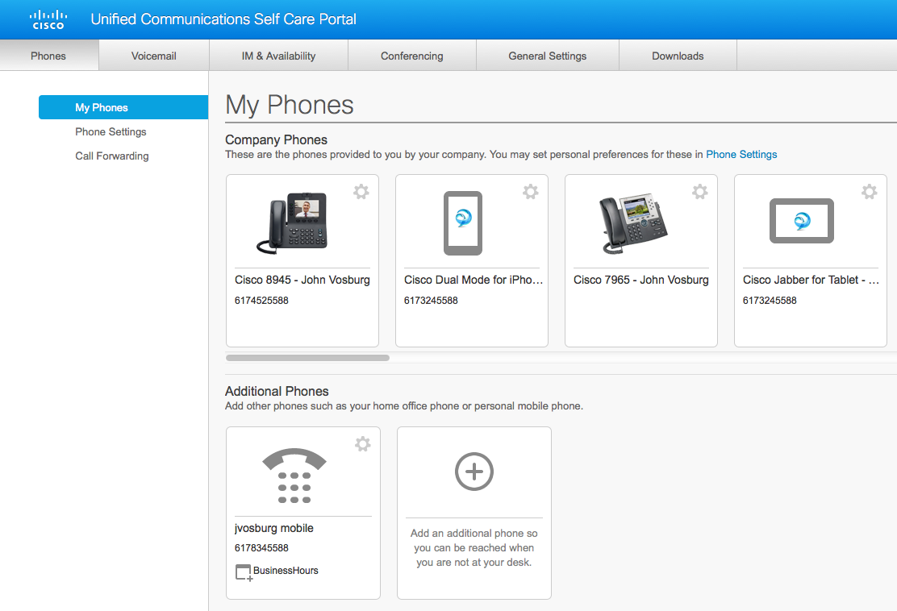
New User Portal

Slide 12
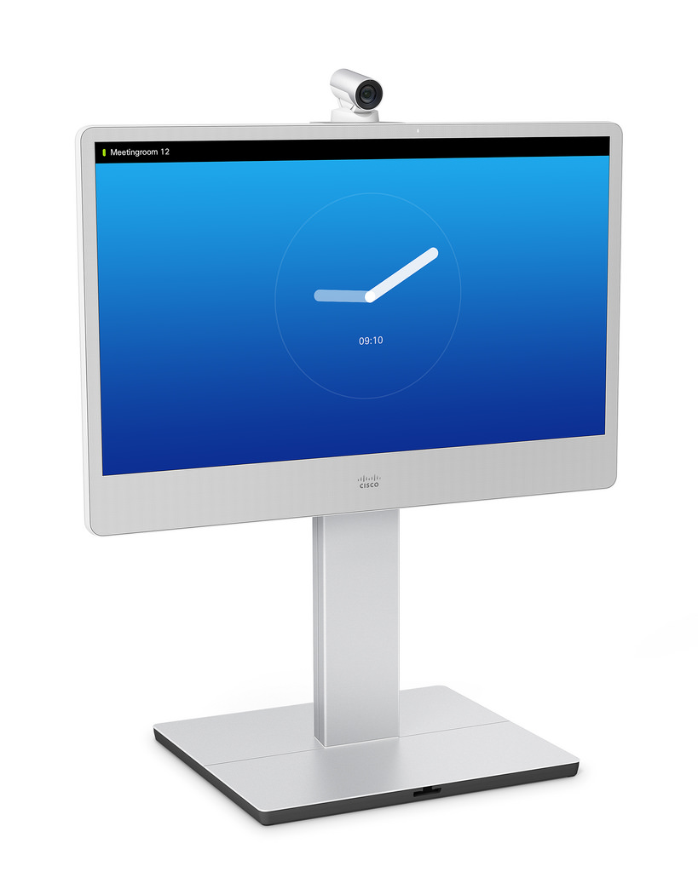
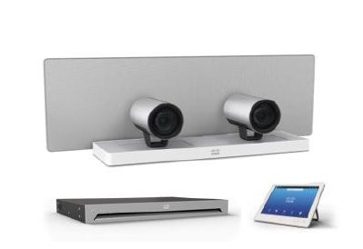
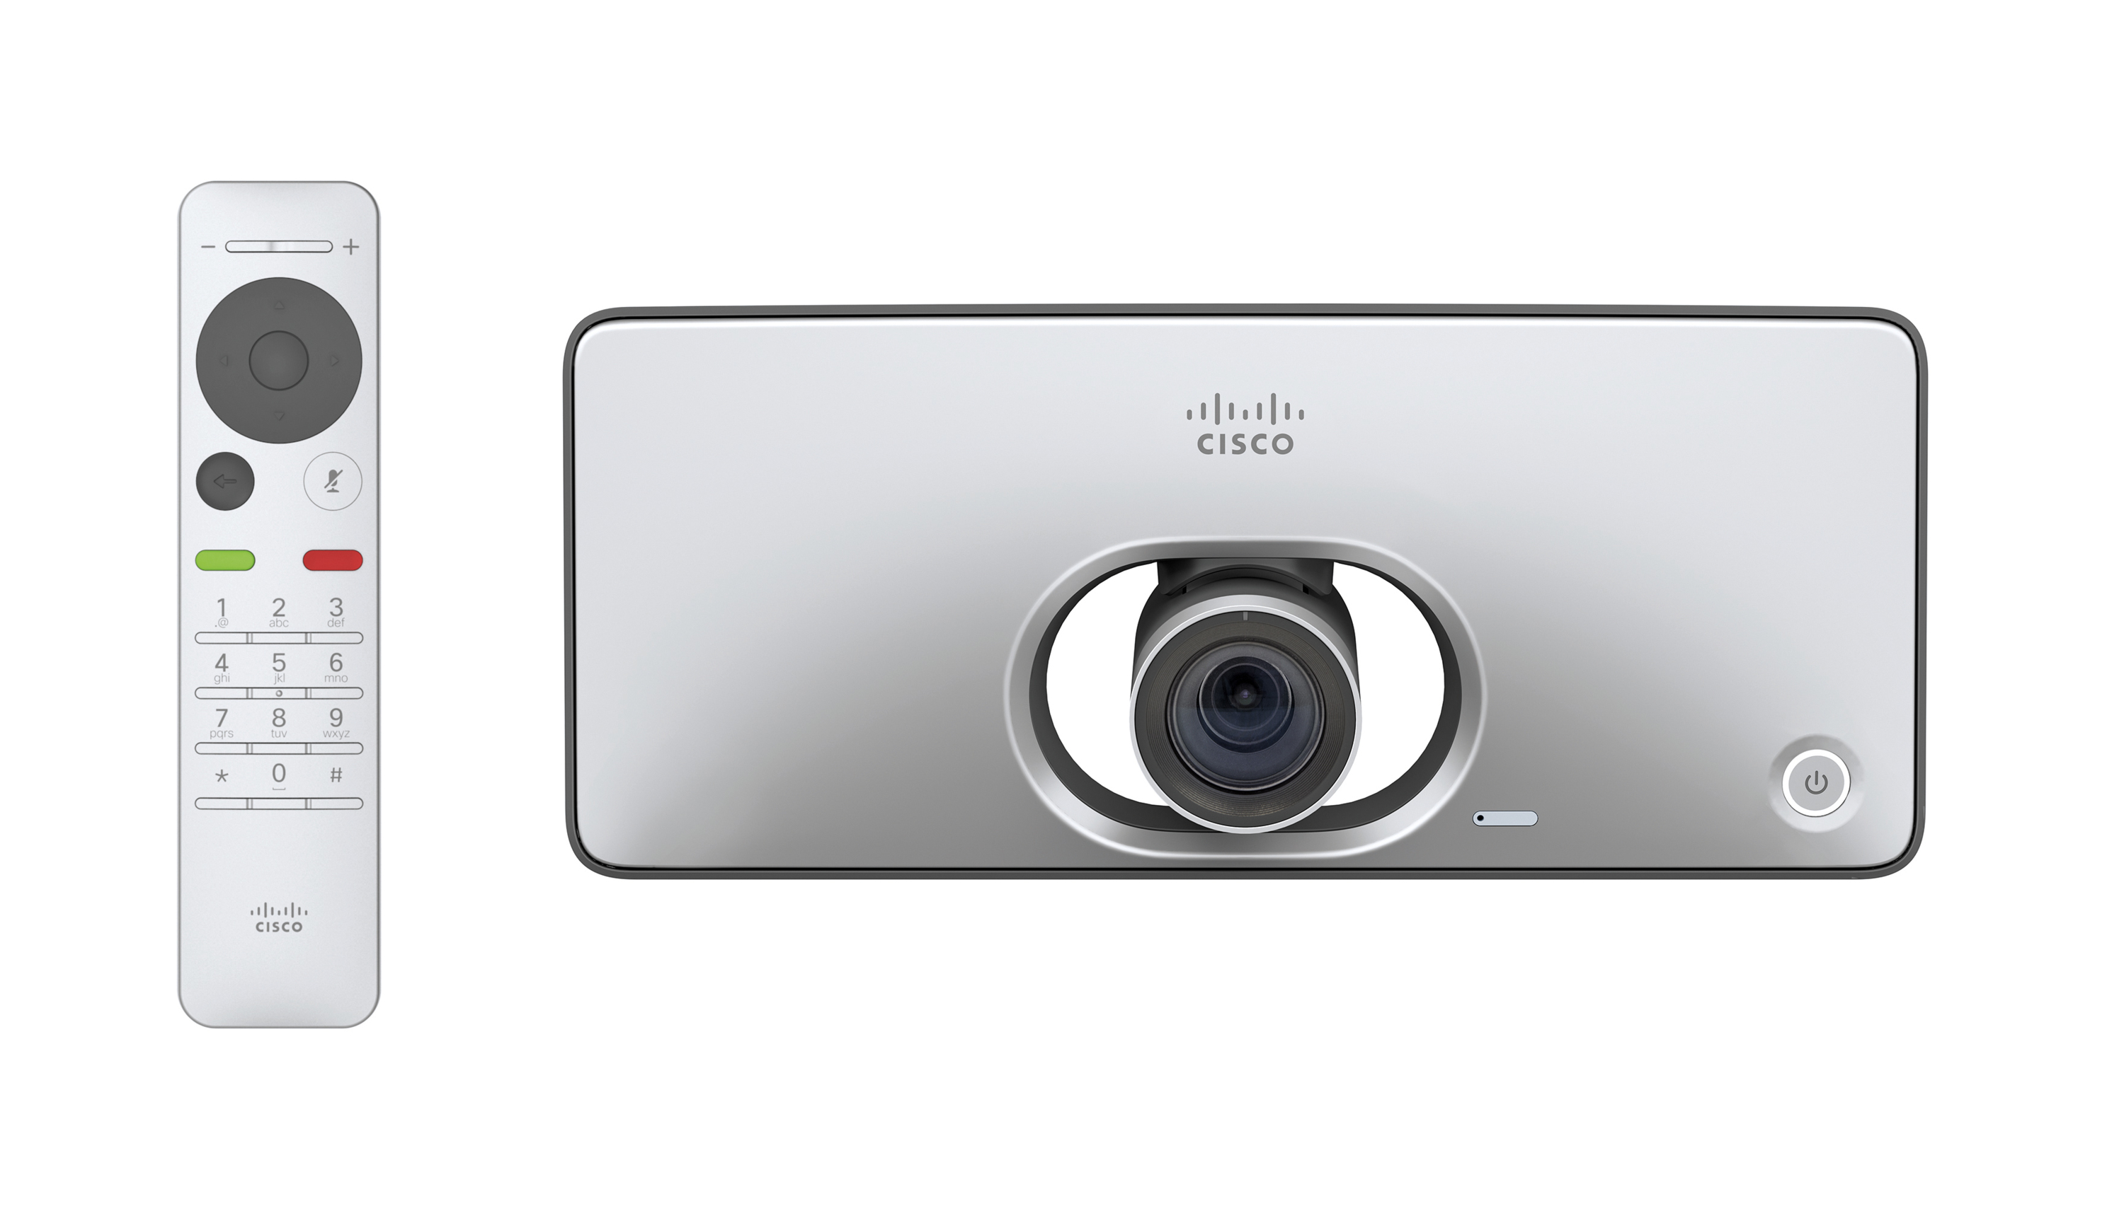
Video
Integration with WebEx
Support for new codecs & video systems
Video on phones, desktop, & mobile
Notes:
Endpoint purchase only. Support contract and firmware IS&T owned
SIP URI, 10-digit and 5-Digit
DX
SX
MX

Slide 13
WebEx Collaboration Platform
Dial-in, call back, and integrated VoIP
Meeting Center
Windows Outlook integration
Mobile support on iOS and Android
Up to 1,000 participants*
Event Center
Large scale events
Up to 3,000 participants*
Collaboration Meeting Rooms
Notes:
Callback and computer audio
Event Center
Customized registration and reports
Lead source tracking and lead scoring
Private preparation room and virtual lobby

Slide 14
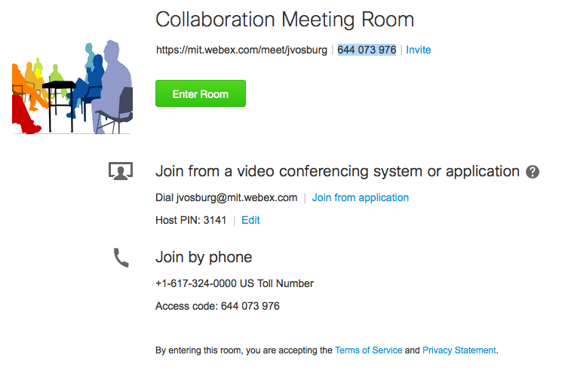
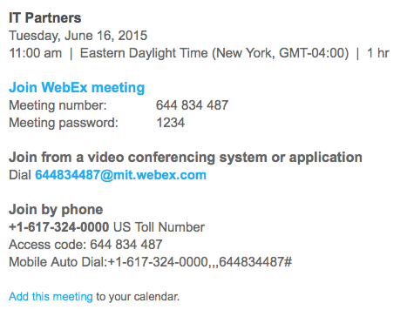
WebEx Video Integration
Instant Meeting
Invite

Slide 15
Voicemail
Phone Access
Single Inbox with Exchange
SMTP message forwarding
Web Inbox
Upgrade this summer

Slide 16
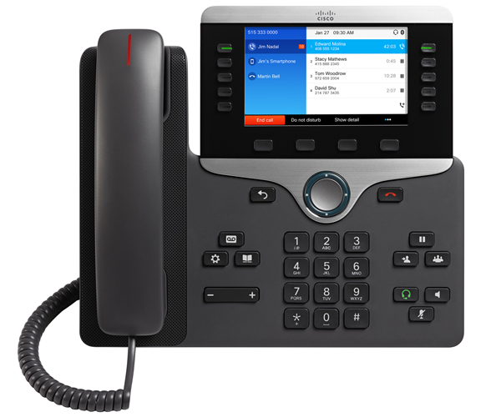
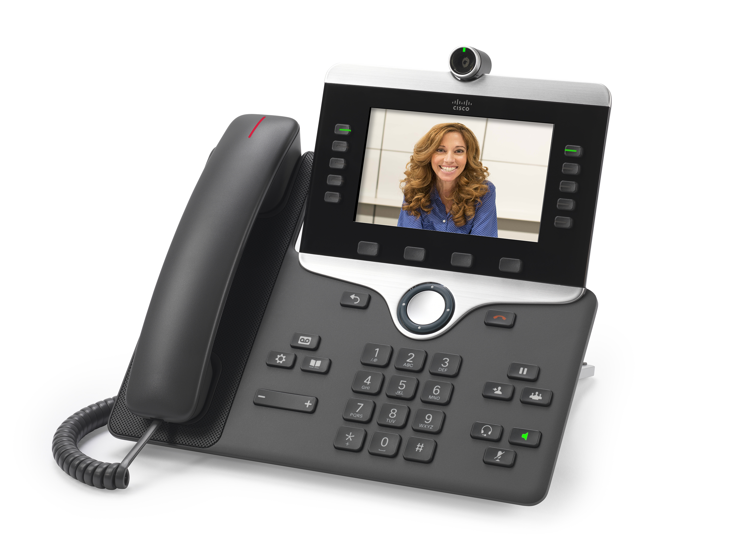
New Phones
800 x 480 WVGA color display
USB 2.0
Cisco 8851
Bluetooth 3.0
Cisco 8845
720p H.264 video

Slide 17
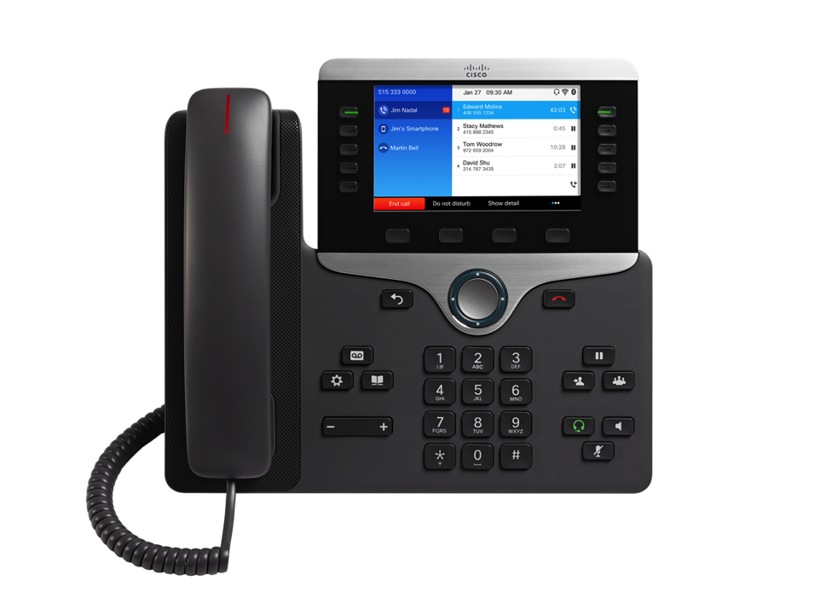
IP Phone 8851 Features
Bluetooth 3.0
RJ-9 and External Audio Port
Visual Ring Indicator
5 Session Keys
Wideband Audio Handset
5” Color Backlit
WVGA Display
800 x 480 Resolution
5 Programmable Line/Feature Keys
4 Soft Label Keys
Messaging, Service, and Directory
Back and Release Keys
4-Way Navigation And Select Key
Wideband Audio Speakerphone
Hold/Resume, Transfer, and Conference
Volume Bar
Keypad
Audio Path Control Keys (Headset, Speaker, Mute)
10/100/1000 Ethernet
USB 2.0 Port Fast Charge Port for Headsets/Smartphones/Tablets
Adjustable Viewing Angle Two- Position Footstand

Slide 18
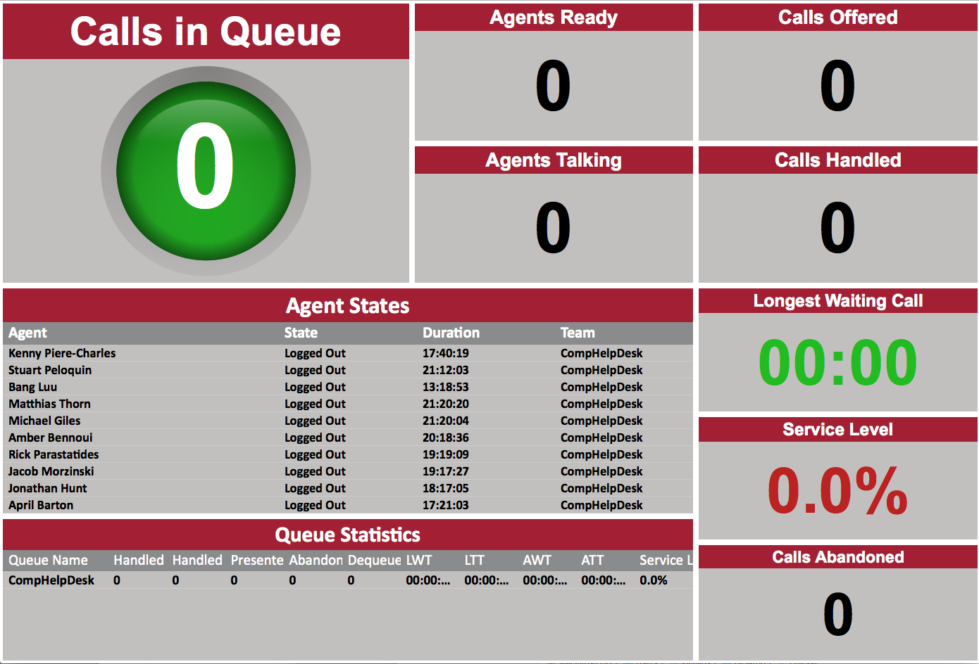
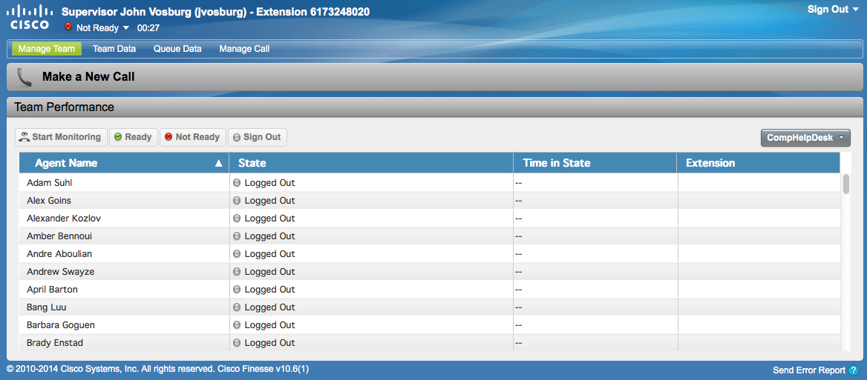
Call Centers
Migration from Eon to Cisco Unified Contact Center Express (UCCX)
Web based agent
Web based wallboard
Notes:
Kerberos
IVR
Finesse
Customizable with gadgets
Embedded call control
Phonebook
Futures
Email
Web Chat
Wallboard
Customizable
View anywhere

Slide 19
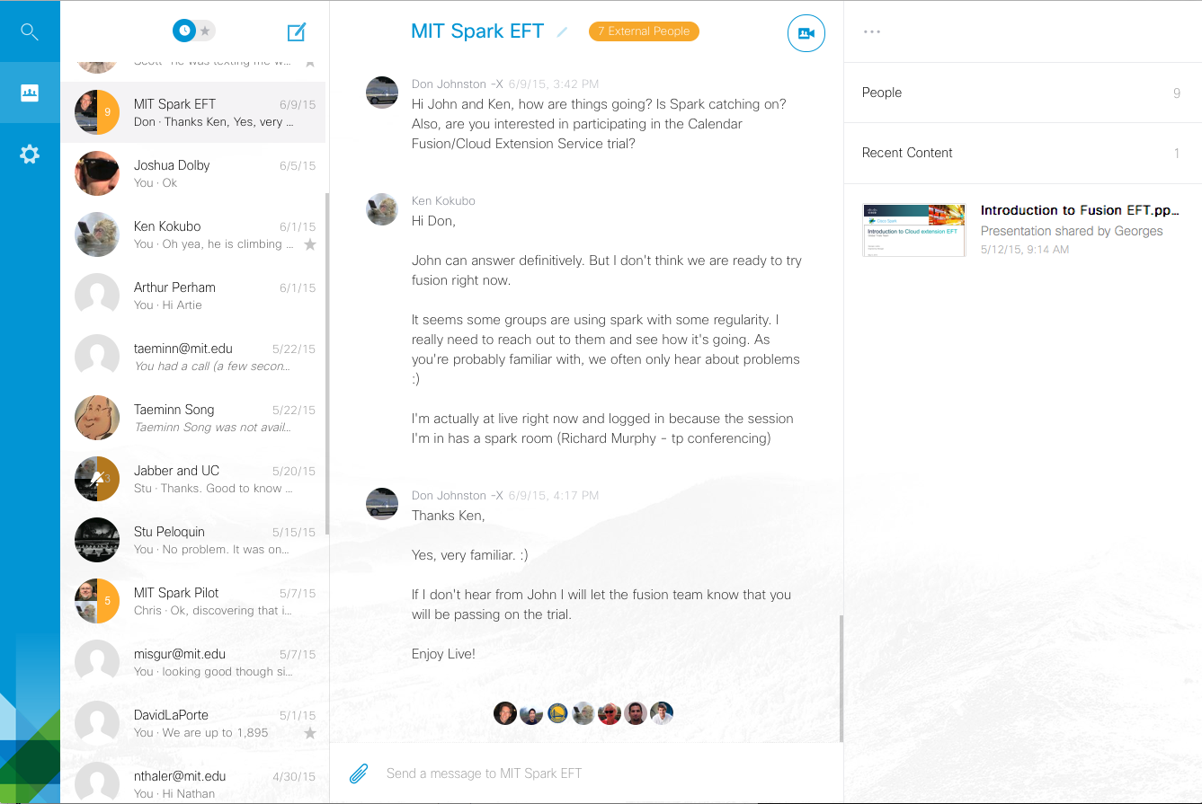
Cisco Spark (Pilot)

Slide 20
Useful Links
SIP Account Management
https://voip.mit.edu
Sylantro / Unity Portal
https://sylantro.mit.edu
WebEx
https://mit.webex.com
Email
nist-uc@mit.edu

